Slide 1
Welcome To York Code Dojo
David Betteridge @da_betteridge
Yorkdevelopers.org
@yorkdevelopers
@yorkcodedojo

Slide 2
Agenda
Quick Introduction
Explain the problem
Work in pairs till 8.45pm
Opportunity to show off solutions
Pub about 9pm

Slide 3
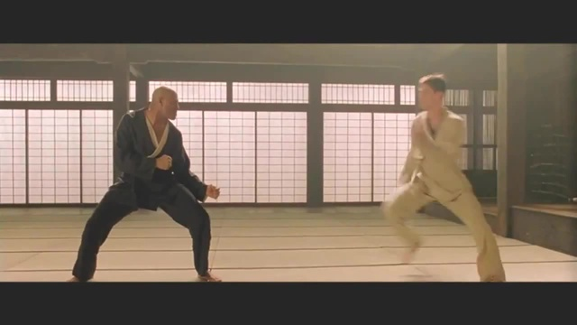
Code Dojo
Notes:
Who has been to a code dojo before?
What is the point?
It’s a place to practice coding safely. By that we mean it doesn’t matter if you haven’t solved the problem by the end of the evening. No one will judge you on it. It’s a place to practice, learn and try out new things.
For example you could use a language you have never used before, partner with someone new, try a different approach to solving the problem. You could add your own constraints; like my functions won’t have more than three lines; or I’m not going to use any IF statements.
(It’s also meant to be fun) It’s driving a car to work every day, you might cover a lot of miles, but if you are doing the same journey then does your driving ability really improve?
It’s driving a car to work every day, you might cover a lot of miles, but if you are doing the same journey then does your driving ability really improve?

Slide 4
Code Golf
The aim is try and make your source code as few as bytes as possible.
Your code must be self-contained – ie. Can’t load in a text file

Slide 5
Fizz Buzz
Print the numbers 1 to 100 unless
If they are divisible by 3 then print Fizz
If they are divisible by 5 then print Buzz
If they are divisible by 3 and 5 then print FizzBuzz
DEMO
Notes:
1 2 Fizz 4 Buzz Fizz
for (int n = 1; n <= 100; n++)
{
if (n % 15 == 0)
Console.WriteLine("FizzBuzz");
else if (n % 5 == 0)
Console.WriteLine("Buzz");
else if (n % 3 == 0)
Console.WriteLine("Fizz");
else
Console.WriteLine(n);
}
Remove {}
Rename Class
<1 instead of == 0
Console.Write \n instead of Console.WriteLine
Single Line
No spaces or tabs
using System;class P{static void Main(){for(int n=1;n<=100;n++)if(n%15<1)Console.Write("FizzBuzz\n"); else if (n % 5 == 0)Console.Write("Buzz\n"); else if (n % 3 == 0)Console.Write("Fizz\n"); else Console.WriteLine(n); Console.ReadKey(true);}}

Slide 6


Short Solutions
http://trelford.com/blog/post/golf.aspx
Notes:
F#
API
Phil Trelford

Slide 7
Tonight
You must write a program which generates the text from this classic piece of English literature
The correct text must be generated – would recommend writing a unit test early on.
The smallest source code file wins. Measured in bytes

Slide 8
GitHub
Please add your solutions to our yorkcodedojo github
Some instructions on the YorkDevelopers.org website.
Click on https://www.yorkdevelopers.org/blog/

Slide 9
Rules
Your program’s output must match http://codegolf.azurewebsites.net/solution.txt
Your program should produce no additional output
The team with the smallest source code in bytes wins
There a few ways to cheat, so try to keep to spirt of the game.
That said, feel free to come up with clever solutions, but they might not be accepted!
Notes:
Leave slide open

Slide 10
Score board
Register your team on http://codegolf.azurewebsites.net
http://codegolf.azurewebsites.net/solution.txt
Update the score board as you get shorter files

Slide 11
York Code Dojo – 2nd Wednesday
13th Feb 2019– Interview style coding problems

Slide 12
York Developers
Code and Coffee
Agile York
Games Developers
Dot Net York

